Slide 1
Create interactive conversational bots for Microsoft Teams

Slide 2
What tasks are best handled by bots?
How do bots work?
How are bots in Microsoft Teams unique?
Developing bots for Microsoft Teams
Basics of conversational bots

Slide 3
Overview of bots in Microsoft Teams

Slide 4
What tasks are best handled by bots?
Bots can in Microsoft Teams can interact with users in the following ways:
1:1 personal conversations
Group chat
Channels in teams
Each scope provides unique opportunities & challenges for a bot

Slide 5
Bots in Team Channels
Channels contain threaded conversations between multiple people
Bots have potential to massive reach to these users
Bots have access to messages where they are directly @mentioned
Additional messages can be retrieved by the bot using Microsoft Graph & additional permissions
Sample bot scenarios:
Notifications
Feedback

Slide 6
Bots in group chats
Group chats are non-threaded conversations between three or more people
Tend to have fewer members, but similar to a channel
Bots have access to messages where they are directly @mentioned
All scenarios where a bot works well in a channel will usually work well in a group chat

Slide 7
Bots in 1:1 personal chats
Personal, 1:1 chats between users and bots is the traditional use case for bots
Enable diverse workloads & can initiate workflows in other systems
Always consider if a bot is the best way to present functionality
Example: wizard approach may work for a bot, or task modules

Slide 8
How do bots work?
Conversation bots consist of the following components:
Publicly accessible web service
Bot registration that identifies your web service with the Microsoft Bot Framework
Teams app registration that identifies the bot and links it with the Bot Framework registration
Build the web service by hand, or use the Microsoft Bot Framework SDK’s
SDKs simplify handling & routing of specific messages, enabling developers to implement overridable methods instead of complex switch / if statements

Slide 9
How are bots in Microsoft Teams unique?
Bots created with the Microsoft Bot Framework are diverse & can be used in multiple channels
Bots developed for Microsoft teams include some differences from the other platforms
Primary difference: how activities are handled
Microsoft Teams activity handler derives from the Bot Framework
Routes all Teams activities before allowing any non-Teams-specific activity to be handled

Slide 10
Microsoft Teams activity handlers
When a Microsoft Teams bot receives an activity, it’s passed to activity handlers
These are derived on one base handler – the turn handler
The turn handler calls the required activity handler to handle the specific type of received activity
When creating bots for Microsoft Teams, use the TeamsActivityHandler class from the SDK that’s derived from the Microsoft Bot Framework ActivityHandler class

Slide 11
Developing bots for Microsoft Teams

Slide 12
Creating conversational bots for Microsoft Teams
Creating a conversational bot for Microsoft Teams requires the following things:
Custom web service
Register the web service as a bot with the Microsoft Bot Framework
Create a Microsoft Teams app manifest and app package
Upload app package to Microsoft Teams

Slide 13
Create a web service
The web service is the heart of your bot
Defines a single HTTPS route where it receives all requests
Microsoft Bot Framework will send different types of messages to your web service
Recommendation: Use the available SDKs to implement your web service
Without the SDK: receive, inspect and process messages of type composeExtension/fetchTask
With the SDK: implement the handleTeamsMessagingExtentionFetchTask() method

Slide 14
Microsoft Teams bot web service
export class ConvoBot extends TeamsActivityHandler {
constructor() {
super();
this.onMessage(async (context, next: () => Promise<void>) => {
const botMessageText: string = context.activity.text.trim().toLowerCase();
if (botMessageText === "mentionme") {
const mention = { mentioned: context.activity.from, type: "mention"
text: `<at>${new TextEncoder().encode(context.activity.from.name)}</at>`
};
const replyActivity = MessageFactory.text(`Hi ${mention.text} from a 1:1 chat.`);
replyActivity.entities = [mention];
await context.sendActivity(replyActivity);
}
await next();
});
} }

Slide 15
Register the web service as a bot with Microsoft Bot Framework
The web service must be registered as a bot with the Microsoft Bot Framework
Provides a secure communication channel between Microsoft Teams clients and your web service
Microsoft Teams & your web service never communicate directly
Microsoft Bot Framework registration is associated with an Azure AD app (new / existing)
Enables the Microsoft Bot Framework to authenticate between Microsoft Teams & your web service

Slide 16
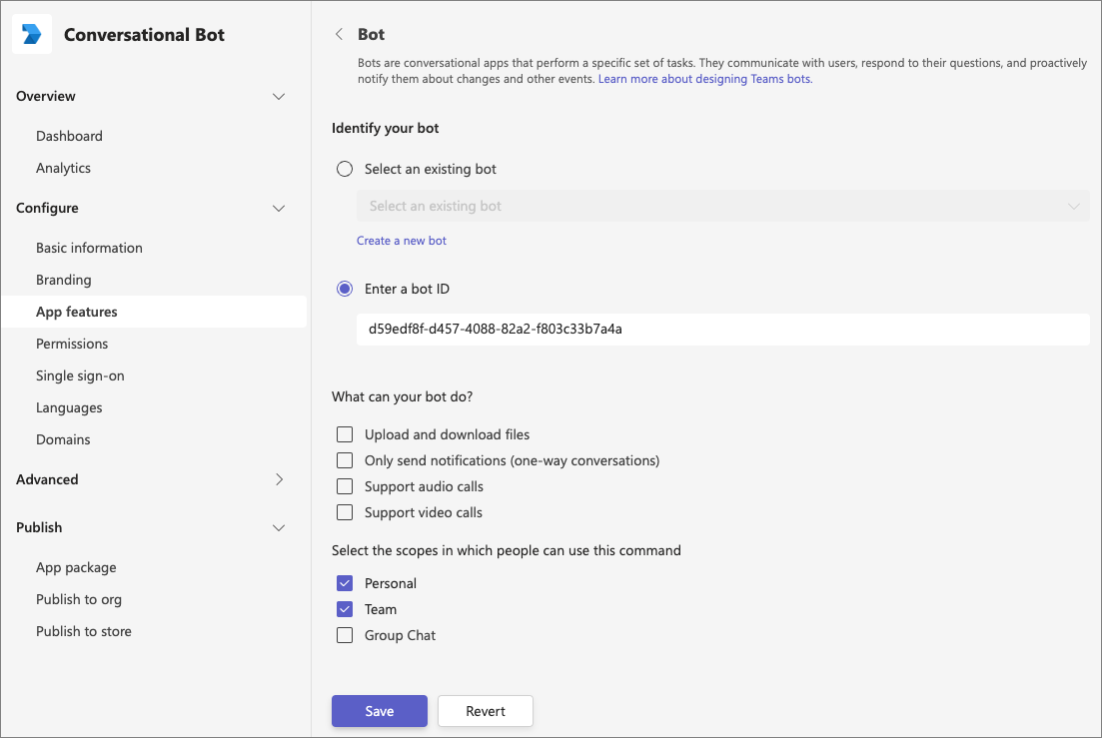
Create your Microsoft Teams app manifest & app package with the Developer Portal

Slide 17
Create your Microsoft Teams app manifest and app package
Bot must be registered with the Microsoft Teams app manifest, then uploaded to Microsoft Teams
"bots": [
{
"botId": "f332cee9-06ba-4bea-acec-9f4d55d1d2a9",
"scopes": ["personal"], "supportsFiles": false, "isNotificationOnly": false,
"commandLists": [
{
"scopes": ["personal"],
"commands": [
{
"title": "MentionMe", "description": "Sends message with @mention of the sender"
}
] } ] } ]

Slide 18
Basics of conversation bots
Conversations are series of messages between one or more users & a bot in an available scope
Team (teams)
Group Chat (groupChat)
Personal (personal)
Bots behave differently depending on the scope
Must be @mentioned to activate the bot in a team conversation / group chat
Can access messages in a personal, 1:1 chat with a user

Slide 19
Basics of conversation bots
Activities
All messages are sent as activities and contain a messageType property
Receive messages
Use the Activity.text property to inspect the message
Send messages
Send an Activity to the Microsoft Bot Framework using the turn context’s SendActivity() method

Slide 20
DEMO
Creating conversational bots for Microsoft Teams

Slide 21
Conversational bots in Microsoft teams
Channel and Group chat conversations with a Microsoft Teams bot

Slide 22
Conversation bots in Microsoft Teams
Microsoft Teams sends notifications to your bot for events that happen scopes where your bot is active
Capture events in our code & take action on them:
Trigger welcome message when your bot is added to a team
Trigger welcome message when a new team member is added or removed
Trigger notifications when channels are created/renamed/deleted
When one of the bot’s messages are liked by users

Slide 23
Conversation update events
Bots receive conversationUpdate events when:
it’s been added to a conversation
other members are added/removed from a conversation
conversation metadata changes
The event is sent to your bot when it receives information on membership updates to teams where it’s been added
Also receives updates when it’s been added for the first time for personal conversations

Slide 24
Channel events
export class MyBot extends TeamsActivityHandler {
constructor() {
super();
this.onTeamsChannelCreatedEvent(async (channelInfo: ChannelInfo, teamInfo: TeamInfo, turnContext: TurnContext, next: () => Promise<void>): Promise<void> => {
const card = CardFactory.adaptiveCard({..});
const message = MessageFactory.attachment(card);
await turnContext.sendActivity(message);
await next();
});
}
}

Slide 25
Channel events bots can subscribe to in Microsoft Teams
Team Member Events
teamMemberAdded
teamMemberRemoved
Payload object contains added/removed members
*Adding bot fires this event
Channel Events
channelCreated
channelRenamed
channelDeleted
ChannelData object reflects current state
Team Events
teamRenamed
ChannelData object reflects current state
Reactions
reactionsAdded
reactionsRemoved
replyToId contains the ID of the specific message

Slide 26
Message Reaction Events
export class ConvoBot extends TeamsActivityHandler {
constructor() {
super();
this.onReactionsAdded(async (context: TurnContext, next: () => Promise<void>) => {
if (context.activity.reactionsAdded) {
context.activity.reactionsAdded.forEach(async (reaction) => {
if (reaction.type === 'like') {
await context.sendActivity(`Thank you!`);
}
});
}
await next();
}); } }

Slide 27
Updating existing messages
export class ConvoBot extends TeamsActivityHandler {
private async updateCardActivity(context): Promise<void> {
const data = context.activity.value;
data.count += 1;
const card = CardFactory.adaptiveCard({..});
await context.updateActivity({
attachments: [card], id: context.activity.replyToId, type: 'message’
});
} }

Slide 28
Deleting existing messages
export class ConvoBot extends TeamsActivityHandler {
private async deleteCardActivity(context): Promise<void> {
await context.deleteActivity(context.activity.replyToId);
}
}

Slide 29
DEMO
Bots in Microsoft Teams channels and group chats

Slide 30
Proactive messages
Creating channel conversations

Slide 31
Proactive messages
Proactive messages are when the bot creates a new message in a channel
Possible scenarios
Welcome message for personal bot conversation
Poll responses
Notification of external events
Consider when to use proactive messages
Proactive messages can be an effective way to communicate with users
However, consider from a user’s perspective, message appears to come to them unprompted
Welcome messages will be the first time they interact with your app
Recommendation: Consider using proactive messages sparingly

Slide 32
Creating a channel conversation
export class ConvoBot extends TeamsActivityHandler {
constructor() {
super();
this.onMessage(async (context: TurnContext, next: () => Promise<void>) => {
const botMessageText: string = context.activity.text.trim().toLowerCase();
if (botMessageText.endsWith("newconversation")) {
const message = MessageFactory.text(”First message in a new thread");
await this.createConversationInChannel(context, message);
}
await next();
});
}
...

Slide 33
Creating a channel conversation
private async createConversationInChannel(context: TurnContext, message: Partial<Activity>): Promise<void> {
// get a reference to the bot adapter & create a connection to the Teams API
const adapter = <BotFrameworkAdapter>context.adapter;
// create a new conversation and get a reference to it
const conversationReference = TurnContext.getConversationReference(context.activity);
// send message
await adapter.continueConversation(conversationReference, async turnContext => {
await turnContext.sendActivity(message);
});
}

Slide 34
DEMO
Proactive messages from bots

